Slide 1

Capstone Project -1 Play Store App Review Analysis
Individual Project Saurabh Shinkar

Slide 2
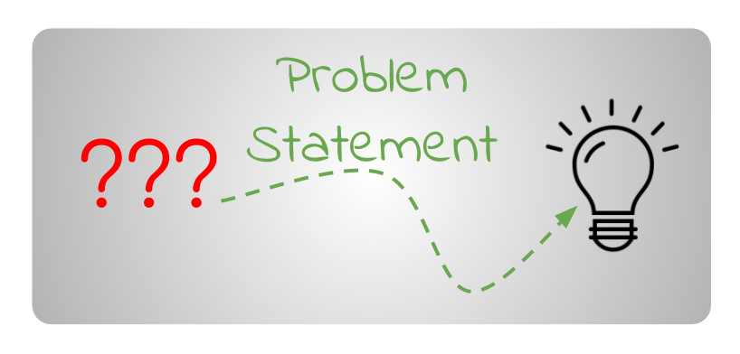
Problem Statement
The Play Store apps data has enormous potential to drive app-making businesses to success. Actionable insights can be drawn for developers to work on and capture the Android market.
Each app (row) has values for category, rating, size, and more. Another dataset contains customer reviews of the android apps.
Explore and analyze the data to discover key factors responsible for app engagement and success.

Slide 3

Understanding Of The Play Store Data
App: Application Name
Category: Category of the Application
Rating: Rating of the Application
Review: Review of the Application
Size: Size of the Application
Installs: No. of installs of the Application
Type: Whether the Application is free or paid
Price: Price of the Application
Content Rating: For whom the content has been created
Genres: Genres to which Application belong
Last updated: Application recently updated Date
Current Ver: Current version of application
Android Ver: Android version of application

Slide 4

Understanding Of The User Reviews Data
App: Application Name
Translated Review: Review In Words
Sentiment: An attitude, thought, or judgment prompted by feeling. It is Positive, Negative or Neutral in our Data.
Sentiment Polarity: It is the expression that determines the sentimental aspect of an opinion
Sentiment Subjectivity: Subjective sentences generally refer to personal opinion, emotion or judgment whereas objective refers to factual information. Subjectivity is also a float which lies in the range of [0,1].

Slide 5

Data Cleaning And Preparation
Handling missing values
Looking for percentage of null values of each column
For columns containing large null values, replacing null with proper values.
For columns containing small null values, dropping those nulls.
For columns containing more than 50% null, dropping whole column.
Making each column values in proper format
Removing unnecessary signs
Changing Type of values into float or integer from string and other format
Handling duplicate values

Slide 6
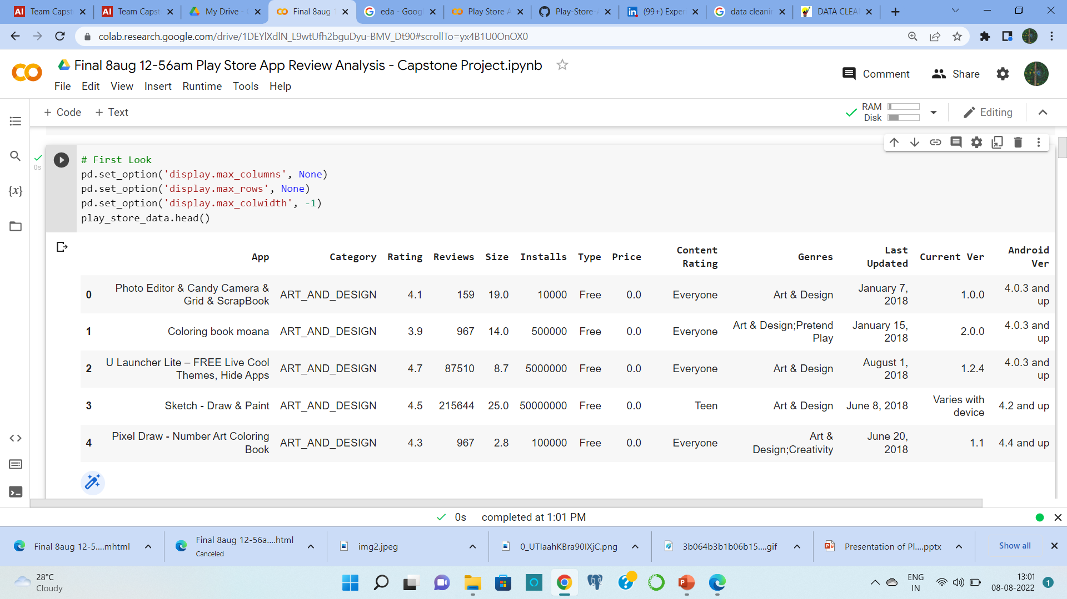
Insights Into The Play Store Data
Range Index: 10841 entries, 0 to 10840
Data columns (total 13 columns)
7 Numerical columns and 6 Categorical columns

Slide 7
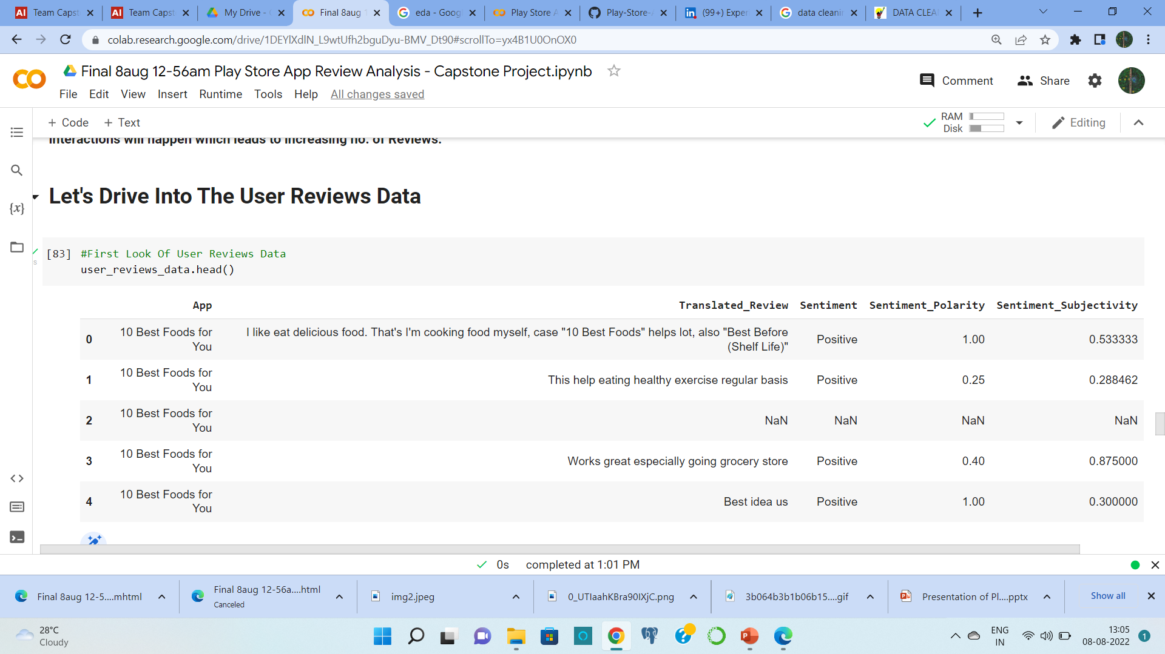
Insights Into The User Reviews Data
Range Index: 64295 entries, 0 to 64294
Data columns (total 5 columns)
2 Numerical and 3 Categorical features

Slide 8
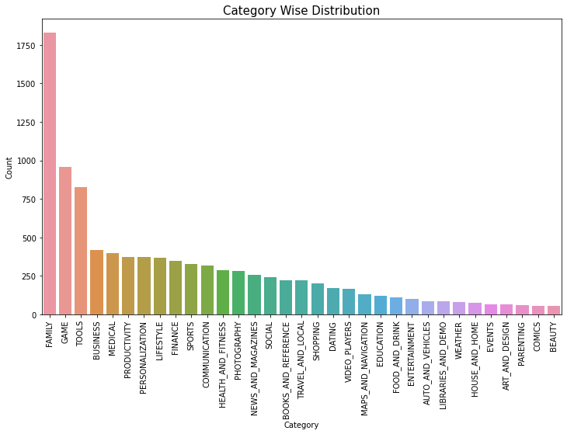
Category Wise Distribution Of The Apps
Family category has the highest no. of Apps

Slide 9
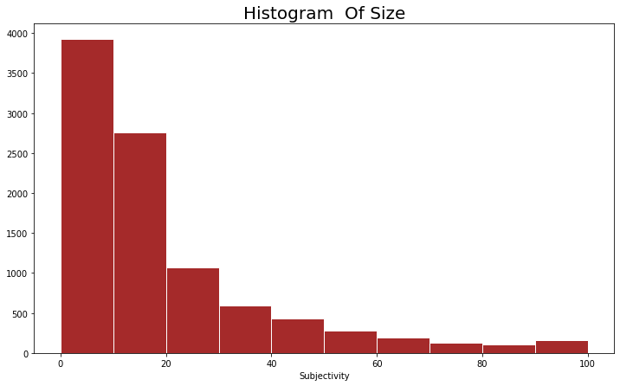
Distribution Of Size
Most the app sizes are in between 0 MB to 20MB

Slide 10
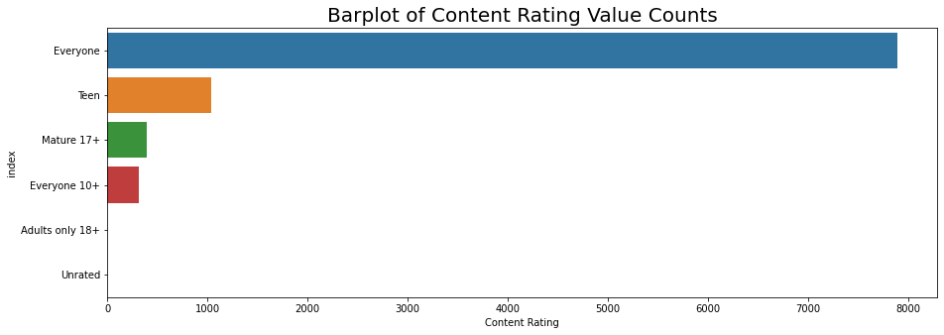
Content Rating Value Counts
Most of The Applications Are Created For Everyone

Slide 11
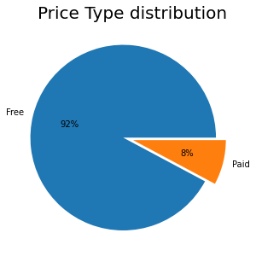
Free And Paid Apps
Approximately 92% apps are free

Slide 12
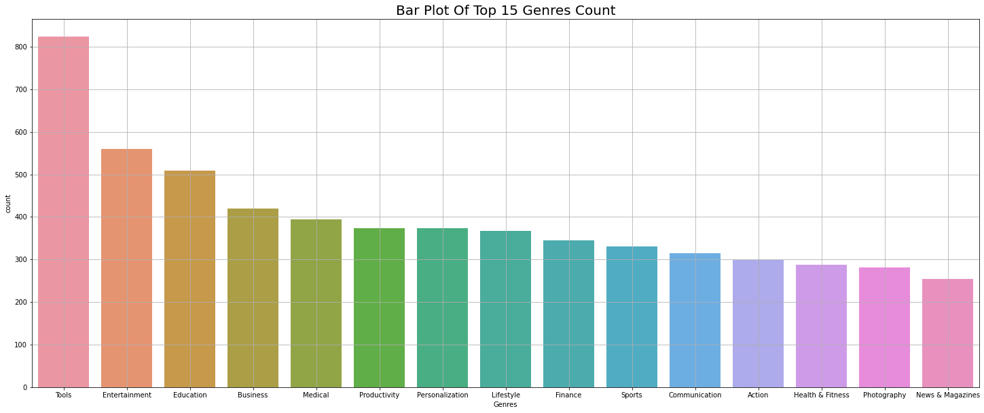
Top 15 Genres Count

Slide 13
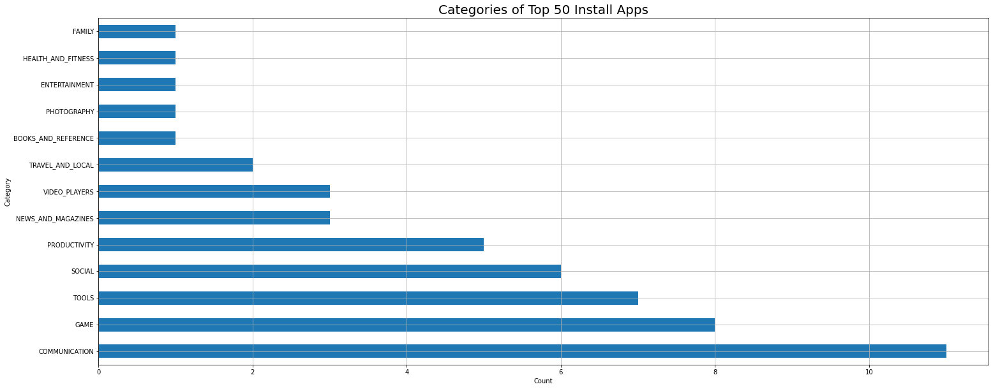
Top 50 Install App’s Category
Communication is the most used category in Top 50 Install

Slide 14
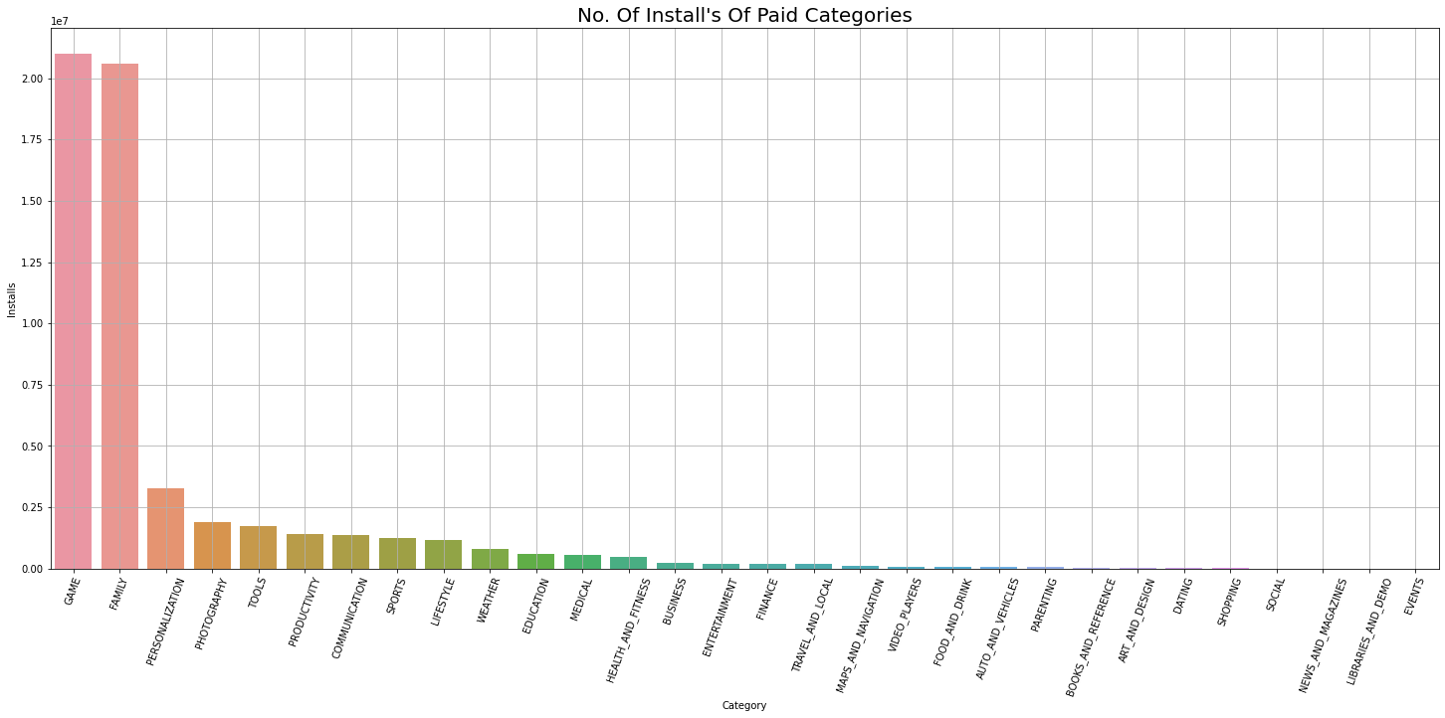
Installs Of Paid Category
Most of the paid apps belongs to the category of Games and Family

Slide 15
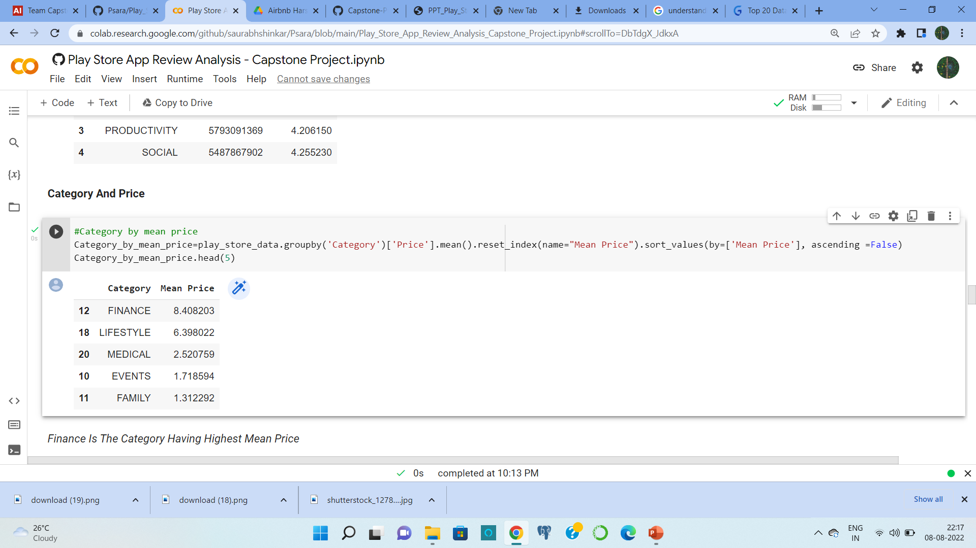
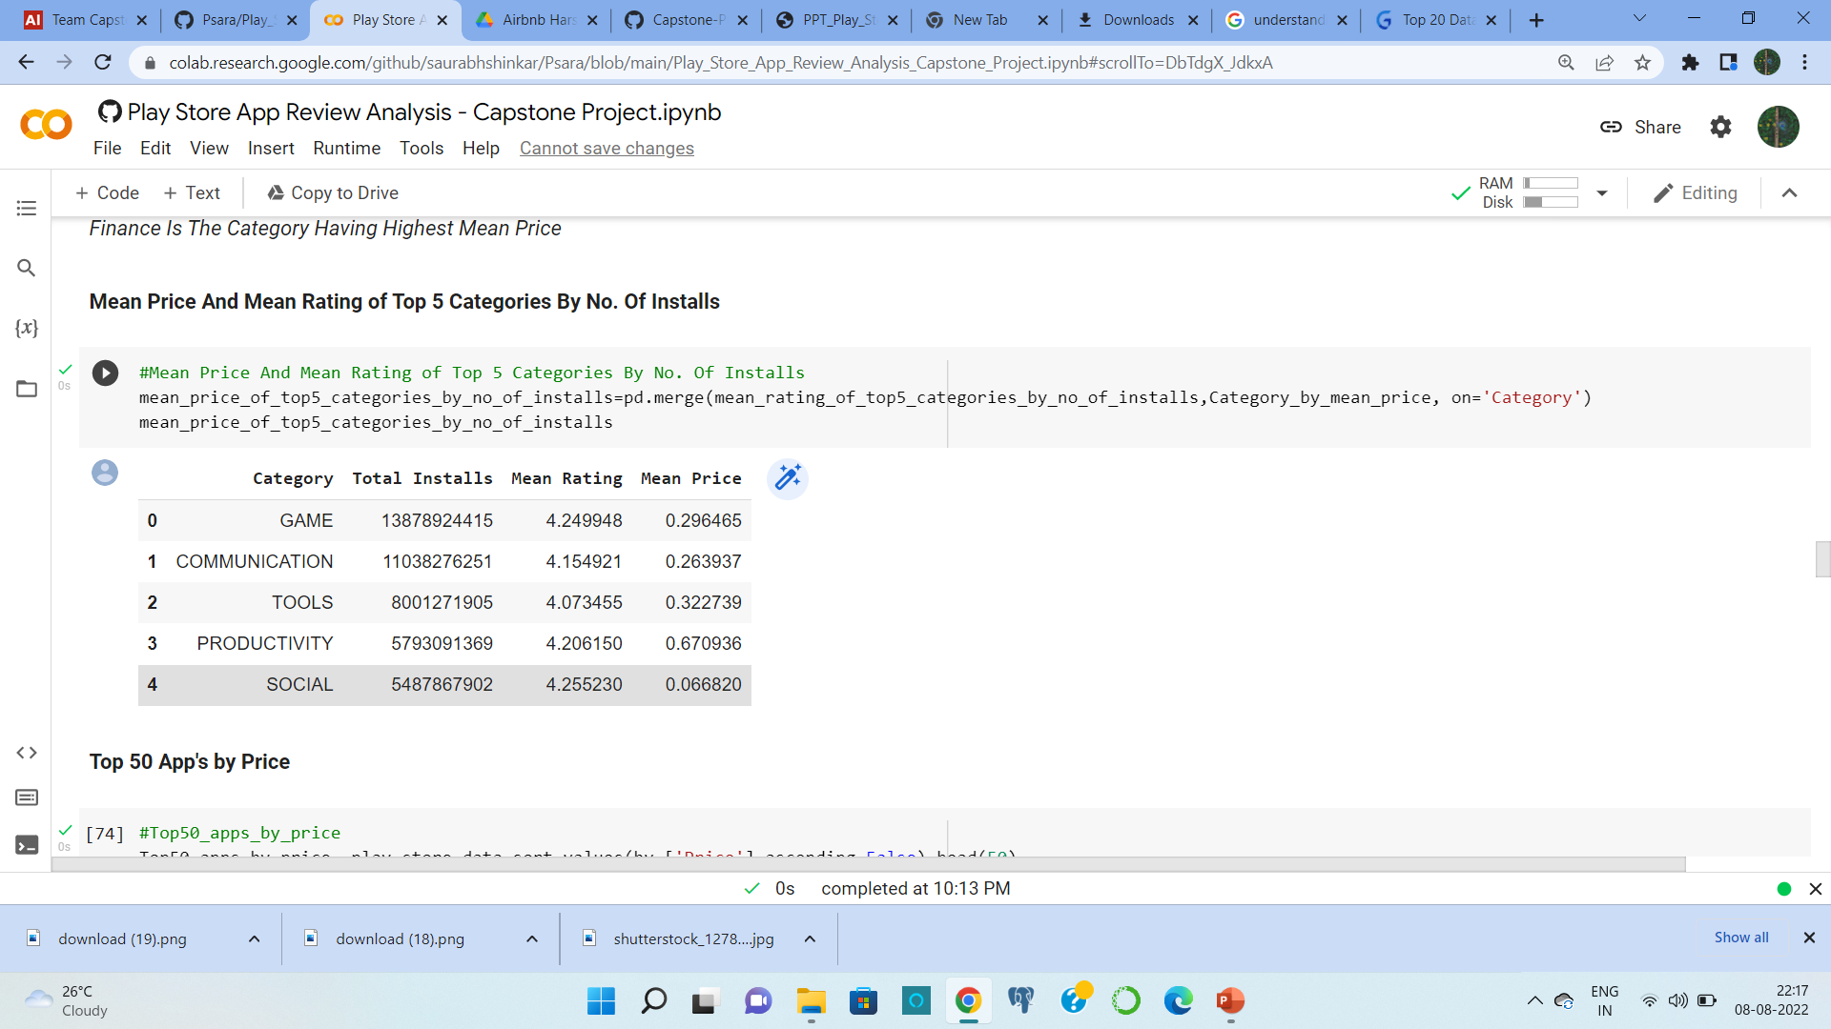
Category Sorted By There Mean Price
Mean Price And Mean Rating of Top 5 Categories By No. Of Installs

Slide 16
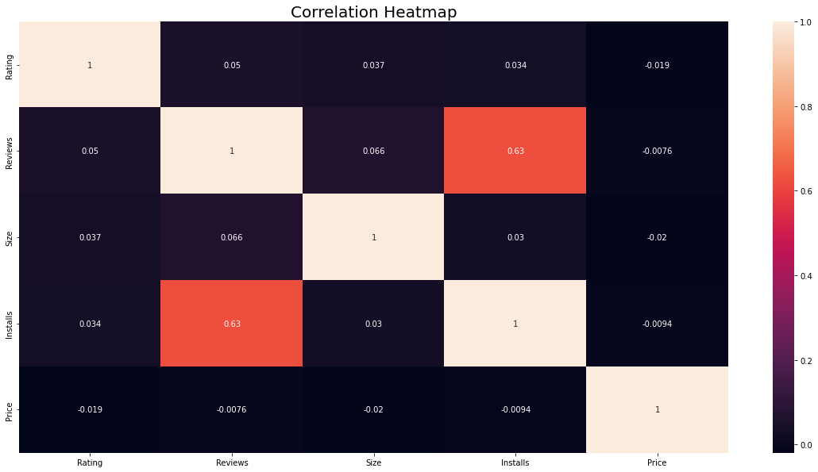
Correlation Heatmap Of The Play Store Data
Installs are positively correlated with reviews with correlation value of 0.63

Slide 17
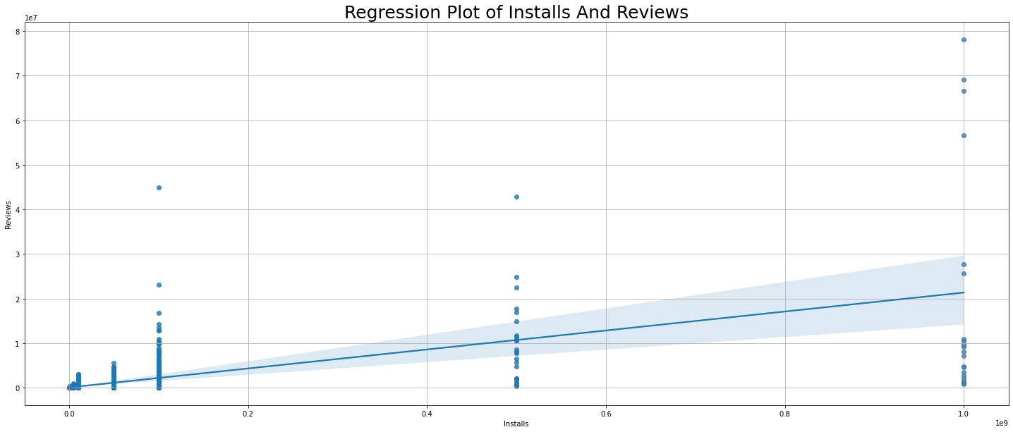
Regression Line Of Installs And Reviews

Slide 18
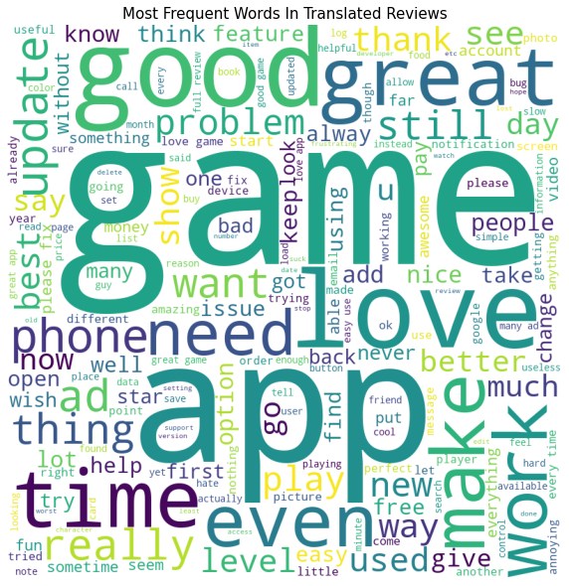
Word Cloud Image Of Translated Reviews

Slide 19
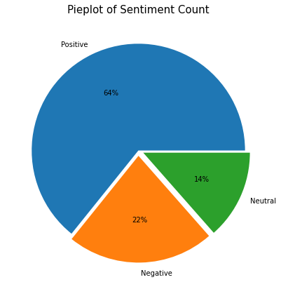
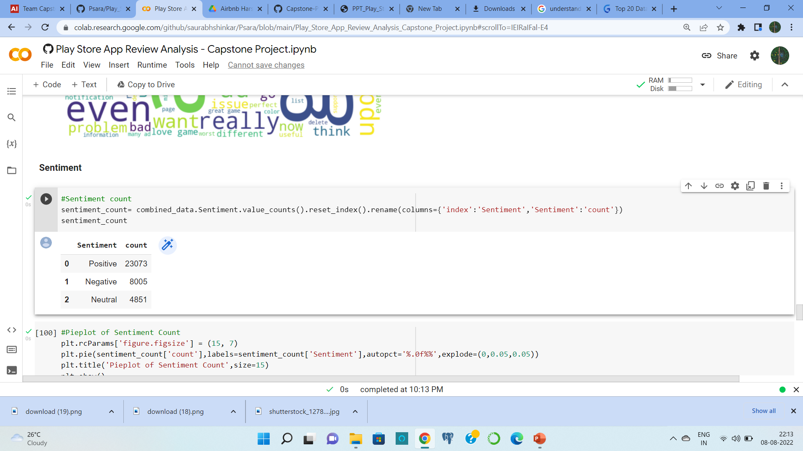
Sentiment Count
64% sentiments are positive, 22% are negative and 14% are neutral.

Slide 20
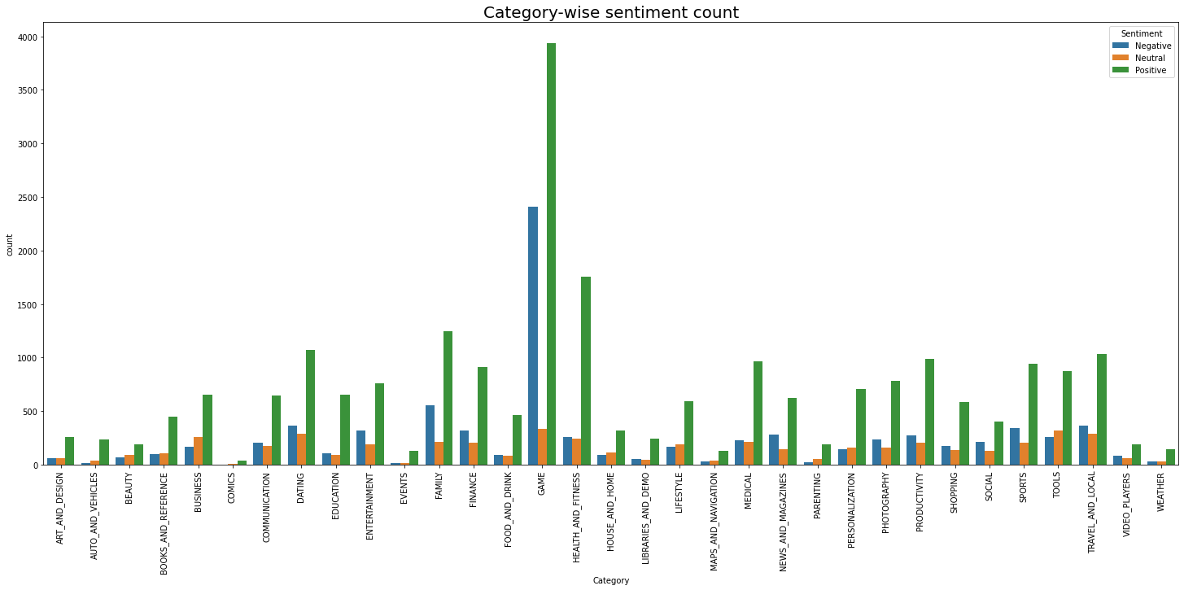
Category And Sentiment Counts
Game category has the most Positive and Negative sentiments

Slide 21
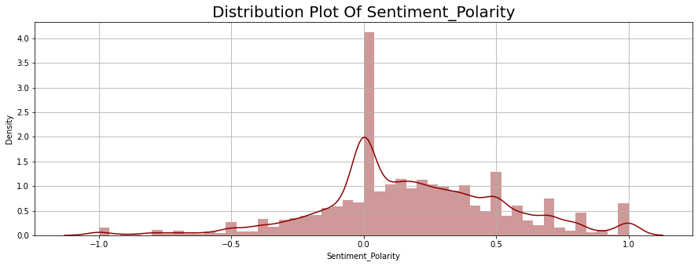
Sentiment Polarity

Slide 22
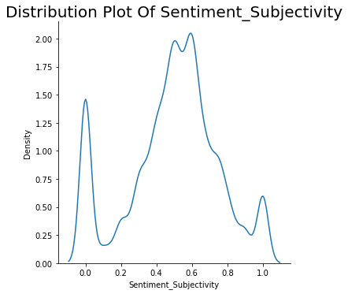
Sentiment Subjectivity

Slide 23
Conclusion’s
Most of the app's belongs to Family category. They are approximately 19% among all categories.
Ratings are negatively skewed with mean rating of 4.19
Sizes are positively skewed with median size of 12 MB.
Prices are positively skewed with mean price of 1,median price of 0 and max price of 400.
Most of The Applications Are Created For Everyone
Approximately 92% apps are free.
Tools, Entertainment and Education are the top 3 genres.
Approximately 64% sentiments are positive, 22% are negative and 14% are neutral.
Mean Sentiment Polarity is 0.180904
Among Top 50 install apps 22% belongs to the communication category and 16% belongs to the Game category.

Slide 24
Conclusion’s (continued)
Events category have the maximum mean rating of 4.395313
Genres of Communication, Tools, Productivity and Social have the maximum no. of installs.
Apps belonging to Finance category have the highest mean price (8.408203) among all categories.
Most of the app sizes are in between 0 MB to 20 MB
Family category has the highest no. of paid apps.
Game And Family Category Have The Highest No. Of Installs Of Paid Apps.
Installs are positively correlated with reviews with correlation value of 0.63
Mean Sentiment Subjectivity is 0.493767
There are 271 apps which have 5 star rating. In which 67 apps belongs to the Family category.

Slide 25


